Slide 1

Thermal stresses : probelms

Slide 2
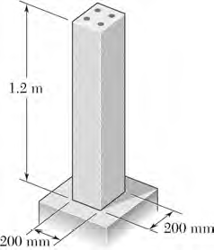
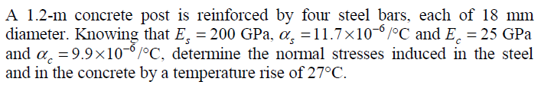
Problem 1

Slide 3
Problem 1
Length = L_{s}=L_{c}=L= 1.2 m for both concrete and steel
A_{c}=a²,a=200mm
A_{s}=nxpxr²=, r= 9mm
n = no of rods = 18
Temperature rise =ΔT=27ºC

Slide 4
Problem 1
Whichever material expands more will have its expansion inhibited by the other.
In this case steel rods will tends to expand more and will try to pull the concrete along with it, while the concrete will try to restrict the expansion of the steel
So steel rods will see a compressive axial force F, while the concrete will see a tensile F.
Note that this F is the total force in the steel rods. Each rod sees F/n.
This is a literary statement of the force equilibrium equation F_{s}+F_{c}=0 or F_{s}=-F_{c}=F

Slide 5
Problem 1
Thus the net expansion of steel rods will have two components
Expansion due to temperature
Expansion (negative and hence compression actually) due to the axial compressive force

Slide 6
Problem 1
The net expansion of concrete will also have two components
Expansion due to temperature
Expansion due to the axial tensile force

Slide 7
Problem 1
The geometrical constraint is that after the temperature stabilizes both steel and concrete rods must have the same length.
Thus

Slide 8
Problem 1
We can now get F by solving this equation

Slide 9
Problem 1
Once F is obtained the stresses in each individual component can be easily found out

Slide 10
Problem 1
What is another way of looking at this problem ?
We have a steel rod and a concrete rod both having the same length. They are both subjected to the same rise in temperature while being acted upon by a force. If the change in length is same in both cases, what is the relation between the forces ? If the magnitude of the forces are same, find the magnitude of the forces and their nature for steel and concrete.

Slide 11
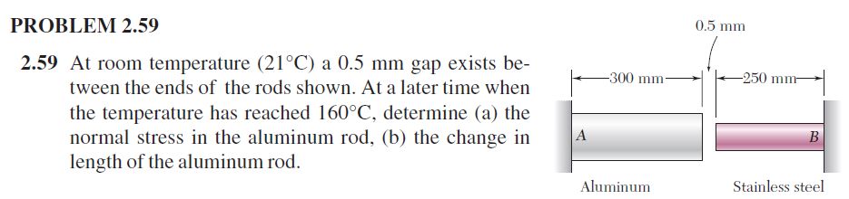
Problem 2

Slide 12
Problem 2
This problem is actually two problems rolled into one. Let us split the problem properly
1. What is the temperature rise required to close the gap between the rods ?
2. After the gap is bridged, what are the forces produced in the rods once the temperature settles down to 160 ºC?

Slide 13
Problem 2
First problem
We let s=0.5mm
C
D
This temperature rise will have to be deducted from the total rise in the second problem

Slide 14
Problem 2
Second problem
The gap is now closed
C and D now coincide.
Let the temperature rise be ΔT₂ for this part
C
D
All the forces generated will be due to ΔT₂.

Slide 15
Problem 2
We draw the FBD
This allows us to write the force equilibrium equation
We also note that will be two domains, AC and CB, since both area of cross section and material change at C.
R_{A}
R_{A}
C
D

Slide 16
Problem 2
Domain AC
R_{A}
F(x)
R_{A}
C
D

Slide 17
Problem 2
Domain CB
R_{A}
F(x)
R_{A}
C
D

Slide 18
Problem 2
Domain CB
R_{A}
F(x)
R_{A}
C
D

Slide 19
Problem 2
Displacement at B due to mechanical effects only
C
D

Slide 20
Problem 2
Thermal expansion
C
D

Slide 21
Problem 2
Geometrical constraint
Why is RHS=0 ?
Because all these expansions are not responsible for bridging the gap. That was due to the expansions calculated in part 1. These new expansions are responsible only for keeping the closed gap closed.
C
D

Slide 22
Problem 2
Using the geometrical constraint we can get the reaction at A after the gap is closed.
C
D

Slide 23
Problem 2
The force in the aluminium rod and the consequent stress is found from our analysis of domain AC
C
D

Slide 24
Problem 2
The expansion of the Aluminium rod will have two parts, the free expansion from part 1 of the problem and the constrained expansion from part 2
C
D

Slide 25
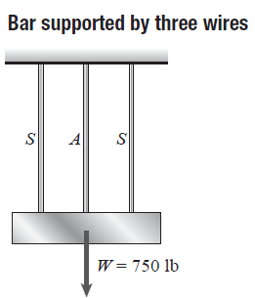
Problem 3
A rigid bar of weight W=340.5 kg hangs from three equally spaced wires, two of steel and one of aluminium. The diameter of the wires is 3.175 mm . Before they were loaded, all three wires had the same length. What temperature increase ΔT in all three wires will result in the entire load being carried by the steel wires? (Assume E_{s} = 207 GPa, α_{s} = 11.7x10-6/°C, α_{al} = 21.6x10-6/°C
W = 340.5 kg

Slide 26
Problem 3
Let us assume all wires expand
We draw the FBD
We write down the equation of force equilibrium. Because of symmetry we do not need to consider the moment equation.
Taking moments about the center of the rigid bar simply tells us that both the steel wires have equal forces, which we can figure out anyway looking at the symmetry of the problem.
F_{al}
F_{s}
F_{s}
W = 340.5 kg

Slide 27
Problem 3
Assuming expansion for all wires implies that both steel and aluminium wires are not loose. There is a possibility that one of them may not be in tension. We will need to check that once our problem is solved with this assumption. We will need to check if all the forces come out as positive with our chosen directions.
If any of them is negative it means that a wire being a wire and not a rod, will not be doing anything, and hence we will have to re do the problem assuming those wires are not there at all
F_{al}
F_{s}
F_{s}
W = 340.5 kg

Slide 28
Problem 3
Expansion due to temperature. These will happen irrespective of whether the wire is loose or tight).
F_{al}
F_{s}
F_{s}
W = 340.5 kg

Slide 29
Problem 3
Expansion due to forces (remember we need to check if these come out as negative)
F_{al}
F_{s}
F_{s}
W = 340.5 kg

Slide 30
Problem 3
Because of the symmetry (both mechanical and thermal, all rods being heated equally), after heating the rigid bar has to be horizontal (Geometrical constraint)
Also both steel and aluminium wires have initial length of L and same area of cross section A. Hence
F_{al}
F_{s}
F_{s}
W

Slide 31
Problem 3
We now combine use the force equilibrium equation and the constraint equation and solve them together
F_{al}
F_{s}
F_{s}
W = 340.5 kg

Slide 32
Problem 3
We get the solution for the force in the aluminium and steel wires
F_{al}
F_{s}
F_{s}
W

Slide 33
Problem 3
Since the aluminium wire must be carrying no force
F_{al}
F_{s}
F_{s}
W

Slide 34
Problem 3
For this temperature rise, force in each steel wire can be directly obtained from the force equilibrium equations by setting the force in the aluminium wire as zero
We could have solved the problem by straight away starting with this value, but the idea was to not only solve this problem but get a more general understanding
F_{al}
F_{s}
F_{s}
W

Slide 35
Problem 3
Once this problem is done using the numerical values, we can try redoing this problem by trying to find out what will happen for temperature rise below the answer obtained and above the answer obtained.
Our solutions will be valid for the first case, where the force in the aluminium wire will come out as positive indicating that the load is borne by all 3 wires
However the same expression will give a negative value for the second case. This indicates that beyond this temperature the aluminium wire will expand too much due to temperature and will become loose. Only the steel wires will carry the weight above this critical temperature rise and the expressions obtained by taking force in aluminium wire as zero will be valid beyond this point.

Slide 36
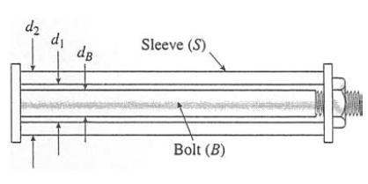
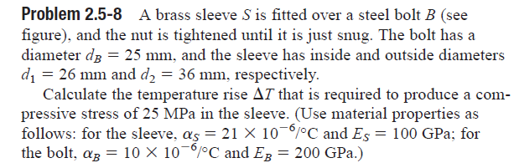
Problem 4

Slide 37
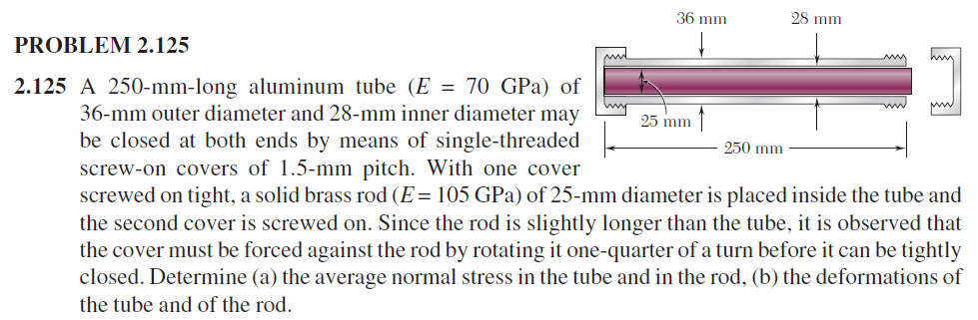
Problem 4
You may want to relook at this problem. The effect of tightening is now replaced by thermal expansion.

Slide 38
Problem 4
In this case, comparing with the earlier problem we can now easily visualize that a temperature increase will cause the bolt with its lower thermal coefficient of expansion to expand less and hence pull at the sleeve from the inside trying to effectively compress it so that the lengths remain as close to equal as possible.
Thus the bolt will be under tension and the sleeve under compression.

Slide 39
Problem 4
With our experience of the earlier problem we will not go into minute details of this problem, such as drawing of FBD of individual components.
We will simply state that the compressive force for the sleeve is F and the tensile force for the bolt is also F.

Slide 40
Problem 4
Thermal expansion of sleeve
Expansion due to compressive force on sleeve
- sign is due to compression
Total change in length

Slide 41
Problem 4
Thermal expansion of bolt
Expansion due to tensile force on bolt
+ sign is due to tension
Total change in length

Slide 42
Problem 4
Geometric constraint is final lengths between the plates are same for both components.
Also initial lengths between the plates are same (L). Hence

Slide 43
Problem 4
Solving

Slide 44
Problem 4
Solving, we can get the required rise in temperature in terms of the force F and hence the stress in the bolt.

Slide 45
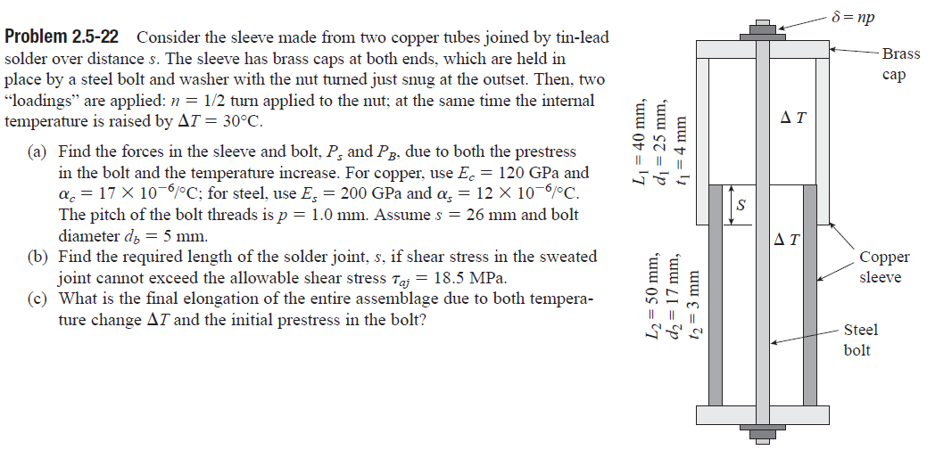
Problem 5

Slide 46
Problem 5
In this problem we have both prestressing (the act of tightening to introduce stresses in the contraption) as well as temperature change.
Note that there are two sleeves, outer and inner, joined by solder.
Also we will deal with shear strength of solder to keep the tubes joined together. This will help us understand how we can deal with shear stresses if screws or pins are used in place of solder or glue in certain problems.

Slide 47
Problem 5
From our experience with previous problems we can now say without detailed FBDs that if the internal force at any transverse cross section of the bolt is F, the internal force for the the sleeve must be –F.

Slide 48
Problem 5
From our experience with previous problems we can now say without detailed FBDs that if the internal force at any transverse cross section of the bolt is F, the internal force for the the sleeve must be –F.

Slide 49
Problem 5
First consider the bolt
Length of bolt is
Area of cross section of the bolt is
Change in length due to force

Slide 50
Problem 5
Bolt
Change in length due to change of temperature

Slide 51
Problem 5
Bolt
Finally we know that the screw was turned to reduce the gap between the top and bottom plates.

Slide 52
Problem 5
Bolt
Total change of length of the bolt

Slide 53
Problem 5
Next consider the outer sleeve excluding the soldered part
Length of outer sleeve is
Area of cross section of outer sleeve is
Change in length due to force

Slide 54
Problem 5
Outer sleeve
Change in length due to change of temperature

Slide 55
Problem 5
Outer sleeve
Total change of length of the outer sleeve

Slide 56
Problem 5
Next consider the soldered part. Note that we are ignoring the solder itself assuming it forms a very thin layer
Length of soldered part is s
Area of cross section of the soldered (jointed) part is
Change in length due to force

Slide 57
Problem 5
Soldered part
Change in length due to change of temperature

Slide 58
Problem 5
Soldered part
Total change of length of the soldered part

Slide 59
Problem 5
Next consider the inner sleeve excluding the soldered part
Length of inner sleeve is
Area of cross section of inner sleeve is
Change in length due to force

Slide 60
Problem 5
Inner sleeve
Change in length due to change of temperature

Slide 61
Problem 5
Inner sleeve
Total change of length of the inner sleeve

Slide 62
Problem 5
Geometrical constraint

Slide 63
Problem 5
We can now get F

Slide 64
Problem 5
The solder must resist this force F. In the solder this will show up as a shearing force between the two sleeves

Slide 65
Problem 5
Suppose we had used N screws with radius r in place of the solder to keep the sleeves joined, with the material of the screw having same allowable shear stress. Then we could find out the number of screws required as shown below

